Slide 1
HYBRID CLOUD SERVICES
Final demo : Apr 28, 2016
-Akash Singh
-Jaison Babu
-Surekha Jadhwani
-Vignesh Shanmuganathan
Mentor: Xu(Simon) Chen

Slide 2
Project Overview
Goals
  Develop an hybrid cloud model that allows application to support data processing in either private or public or both clouds with seamless data distribution.
  Easy user configuration to identify sensitive and non-sensitive data.
  Data segregation of live twitter feed using tagging mechanism that allows distribution of data between private and public cloud.
  Performance benchmarking of data analysis jobs between private, public and hybrid cloud.

Slide 3
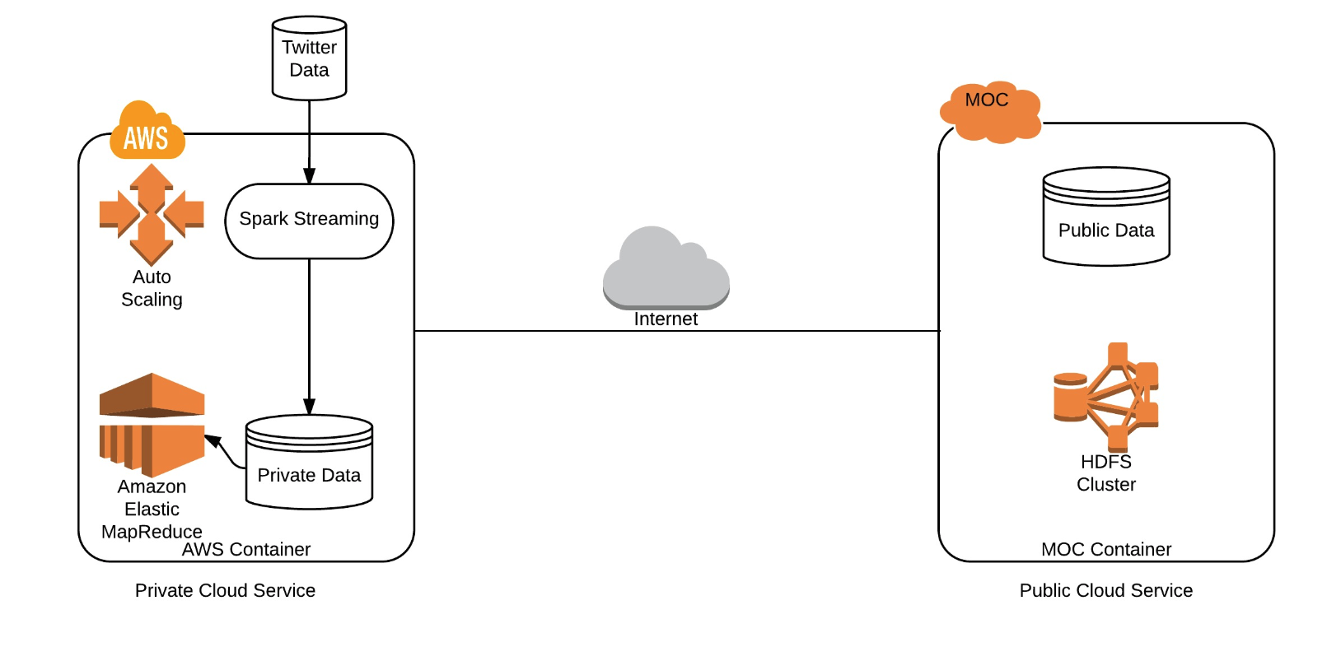
Cluster Configuration:
AWS Configuration :
MOC Configuration:
No of machines: 2
Ram: 8GB/machine
Storage: 15GB/machine
Sensitive Data: 4GB
No of machines: 5
Ram: 8GB/machine
Storage: 80GB/machine
Sensitive Data: 15GB

Slide 4
Trace back the path:
Progress = 100% goals achieved and stretch goal auto-scaling completed.
Creating a public cloud in MOC that contains non-sensitive data.
Creating a private cloud in AWS that contains sensitive data.
Set-up of Hadoop clusters in AWS and MOC.
Establishing communication between AWS and MOC for data transfers.
A spark streaming service running on AWS will gather real time data from twitter and partition data according to user configuration for classifying data as sensitive/non-sensitive. The proposed data classifiers include hash tag mechanism and linguistics.
Based on the twitter hashtags, the created classifier will distribute data across AWS and MOC and write it on their HDFS
Running jobs in the following setups:
  Running data analysis job on public cloud spanning the complete dataset (sensitive and non-sensitive data).
  Running data analysis job on private cloud spanning the complete dataset.
  Running data analysis job on non-sensitive data on public cloud and on sensitive data on private cloud, in parallel.
Performing benchmark analysis on the above proposed configurations.
Auto-scaling for private cloud.

Slide 5
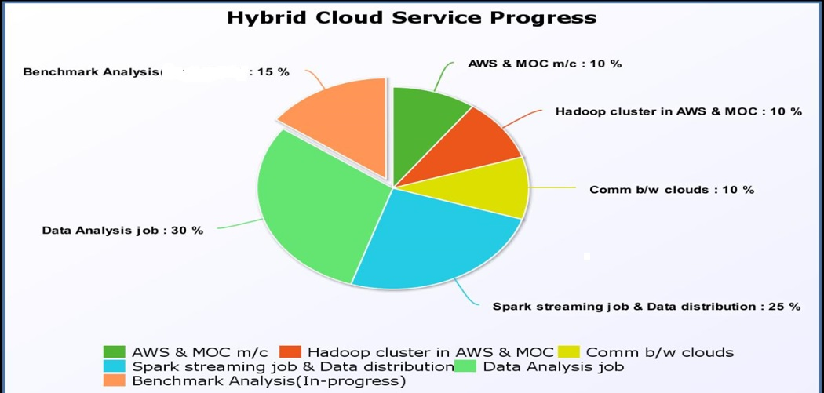
Weightage of the tasks:

Slide 6
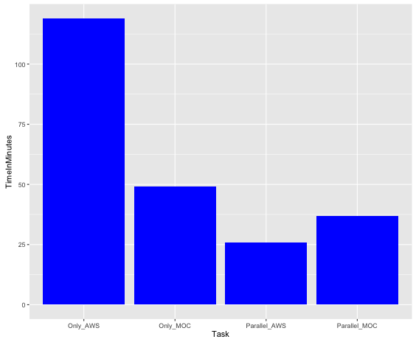
Performance Results:

Slide 7
Major Innovations:
User defined data tagging mechanism to segregate data between private and public cloud without compromising sensitive information from a large data warehouse
Secured data transfer between private and public clouds
One Auto-scaling feature (stretch goal)

Slide 8
Learnings from the Project:
Private cloud and public cloud set-up in AWS and MOC
Configuring HDFS in cluster mode
Learned and worked on new technologies like Spark, Hadoop MapReduce, Twitter API.
Distributed jobs such as Spark streaming, Hadoop analytics job
Allowing data communication between private and public cloud
Use of SSL layer between private and public cloud to ship the data
Understanding and using recursive folder structure to implement auto-scaling as well as running complex analytical MapReduce job
Task tracking tool such as Trello

Slide 9
Problems Faced:
Setting up AWS and MOC environment
  Packaging and deploying spark streaming application:
  Created build.sbt to add dependent jar files.
  Issues with sbt packaging which led to changing project structure to maven
  Filtering twitter feeds based on user configuration from live stream:
  Used Java lambda functions to filter twitter Status object and then mapped the filter Status object Collection to retrieve twitter feed text.
  Migrated to twiter4j library to the filter data based on language
  Insufficient memory in private cloud lead to limitation on analytical job performance:
  Upgrades the AWS machine memory from 1GB to 8GB
  Analytical jobs on spark had poor performance:
  Converted spark analytical jobs to Hadoop MapReduce jobs.

Slide 10
Limitations:
Currently the hybrid service has been modelled to work for data from twitter based on provided tweet tags.
Type of analytical job depends on the meta data provided by twitter.
Communication security depends on Linux security layer.
Makes an assumption that a VPN can be created between MOC (public) and AWS (private) cloud.

Slide 11
Future scope:
Extend the security layer between private and public cloud by implementing an VPN communication layer.
Current data segregation method relies on preprocessed text inputs, extend the data segregation for generic data by preprocessing using a spark job.
Extend auto-scaling to modify number of private and public cluster nodes based on requirement of analytical job.
Provide cluster backup in case of any fatal issue with the cluster.

Slide 12
References
For the demo video and project code, please visit our Github link.
Github Link : https://github.com/BU-NU-CLOUD-SP16/Hybrid-cloud-services

Slide 13
Thank You

